Slide 1

Database Auditing
Level-Advanced
C3: Protected

Slide 2

About the Author
Created By: | Anirudhan Velur (142252)
Credential Information: | Senior Architect More than 10+ years experience
Version and Date: | DM/PPT/0209/1.0
Cognizant Certified Official Curriculum

Slide 3









Icons Used
Hands on Exercise
Questions
Tools
Coding Standards
Test Your Understanding
Reference
A Welcome Break
Contacts
Demonstration

Slide 4
Database Auditing:Overview
Introduction:
This chapter provides the overview of a database auditing, its importance and Design techniques.

Slide 5
Database Auditing: Objectives
Objective:
After completing this chapter you will be able to:
Explain the need for Database Auditing
Explain the Auditing Techniques
Explain the Auditing tools

Slide 6
Database Auditing
Auditing:
Database security is a serious issue that can affect the information security systems by causing its damage and result in eventual loss of an organization .
It is common for an organization to make every effort to lock down their network, but leave the database vulnerable.
It is critical to protect the database from unauthorized access because 90% of the organization’s sensitive information is contained within their database.
Unauthorized access into the database could be catastrophic to a company.
Database Audit is keeping track of who did what and when.
Notes:
Entity-relationship model is a data modeling method applied to model a system and its requirements in a top-down approach. This approach is commonly applied in Database design. The diagrams created applying this method are called ER diagrams.
An entity-relationship model (ERM) is a representation of structured data. Entity-relationship modeling is the process of generating these models. The end-product of the modeling process is an entity-relationship diagram (ERD) or ER diagram, a type of conceptual data model or semantic data model.
A data dictionary is a set of meta data that contains definitions and representations of data elements.
One benefit of a well-prepared data dictionary is a consistency between data items across different tables. For example: Several tables may hold telephone numbers, applying a data dictionary the format of this telephone number field will be consistent.
When an organization builds an enterprise-wide data dictionary, it may include both semantics and representational definitions for data elements. The semantic components focus on creating precise meaning of data elements. Representation definitions include how data elements are stored in a computer structure such as an integer, string or date format .Data dictionaries are one step along a pathway of creating precise semantic definitions for an organization.
The documentation of data model includes , decision logs, information about Business rules or procedures, names of the conceptual logical data model from which the current data model is derived.

Slide 7
Reasons for Auditing Mechanism
The following are some of the reasons for auditing mechanism, which are incorporated in business applications:
Puts accountability for data privacy and integrity on the company
Stipulates control measures that provide traceable evidence of security and demonstrate improvement over time
Requires these control measures to assess security exposures and monitor for unauthorized, malicious, or abusive behavior from inside and outside threats
Mandates companies maintain complete records for all aspects of database information

Slide 8
Database Auditing Security Legislation and Regulations
Database Auditing Security legislation and regulations :
Payment Card Industry Data Security Standard (PCIDSS)
Sarbanes-Oxley Act
HIPAA (Health Insurance Portability and Accountability Act)
European Union Data Protection Directive
California’s Database Security Breach Notification Act(California Senate Bill 1386)
Gramm-Leach-Bliley Act
Federal Information Security Management Act

Slide 9
Database Auditing
Database Auditing Overview
Auditing
Application Uses
DBA
Compliance
DBMS Specific Auditing
Custom Auditing
3rd Party Tools
Reporting

Slide 10
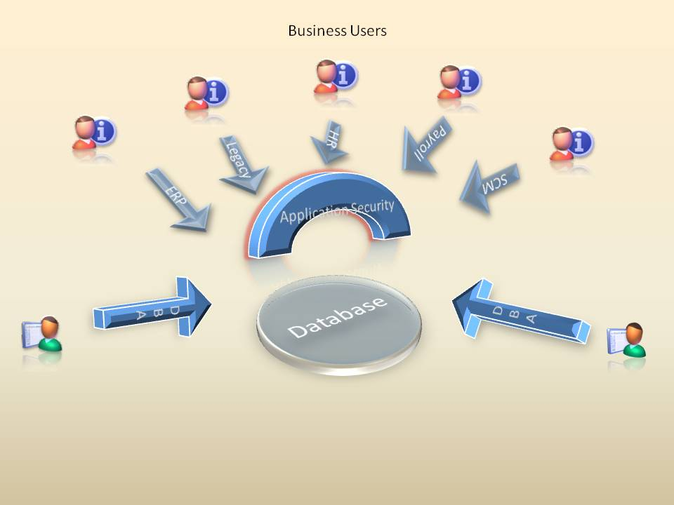
Database Auditing (Contd.)
At Enterprise level, the Data auditing has a role to play in all three types of database application/ users and their access and their activities
Packaged (Like ERP) business applications (Business Users )
Legacy and Custom Applications( Business Users)
Direct Access by Privileged Users(DBA)

Slide 11
Database Auditing (Contd.)
Packaged business applications:
Contemporary packaged business applications (such as PeopleSoft, Oracle Financials, and so on) have recently added some level of application controls. Most organizations have done a reasonably good job as part of SOX preparation work in understanding those application controls and activity logging capabilities
Legacy and Custom Applications:
In larger organizations, a majority of their business applications may be custom-built or legacy applications; all enterprises have some number of these applications that are homegrown or purchased from vendors who are no longer viable. Most of these applications were designed and built before the current climate of strong controls, so they have no or inadequate ability to control access and, more importantly, log critical database activity
Direct Access by Privileged Users (DBA):
This is the most visible and obvious issue and a primary issue being documented by external auditors in their SOX assessment. This class of users – particularly DBAs and developers – must have extraordinary access to as part of their job function, implying an inherent separation of duty problem

Slide 12
Database Auditing (Contd.)
Auditing is typically used to:
Enable future accountability for current actions taken in a particular schema, table, or row, or affecting specific content
Deter users (or others) from inappropriate actions based on that accountability
Investigate suspicious activity

Slide 13
Audit Trail
Audit trail or audit log is a chronological sequence of audit records, each of which contains evidence directly pertaining to and resulting from the execution of a business process or system function.
An audit trail is a mechanism for a complete reconstruction of every action taken against the database.

Slide 14
Custom Auditing
Designing a Custom Auditing
Three basic objects need to be in Audit Trail:
The user. Who initiated a transaction, from what terminal, and when?
The transaction. What was the exact transaction that was initiated?
The data. What was the result of the transaction? What were the database states before and after the transaction initiation?
In addition to the actual recording of all events that take place in the database, an audit trail must also provide query support for auditing.
When you develop a custom build auditing system, you need to decide on what are the things need to capture at what level.
The DML changes can be performed on two levels:
Row level
Column level

Slide 15
Database Auditing (Contd.)
In an auditable system, there must be a way to examine an old value of an attribute and to allow correction to this old value. At the same time, the database should retain the old value for future query and re-examination.
This requires at least two time dimensions: one time dimension to order every operation against an object and a second time dimension to time stamp values of objects with their periods of validity in the real world.
This second time dimension is different from the first time dimension since an earlier value of an object may be corrected later in time

Slide 16
Exercise
XYZ company has Salary Database and has an entity called EMPLOYEE having two attributes NAME and SALARY. Suppose we inserted the record (John, 15K) on 1/11/03. On 3/2/06, we discovered an error in Johns’s salary and made a retroactive change to 20K. Now, in an auditable system such as we discuss here, it is possible to overwrite errors, but records will be kept of any errors that are corrected. Thus, we need to retain both facts in the database:
1. John’s salary was known to be 15K from 1/11/03 to 3/2/06.
2. On 3/2/06, a change was made to the salary from 15K to 20K, and this change was retroactive [relating or applying to things that have happened in the past as well as the present]
Notes:
If you simply change the salary from 15K to 20K, you lose the second fact that an error was discovered in John’s salary on 3/2/06, a change was made, and this change was retroactive. On the other hand, if you just change the value of the first time parameter from 1/11/03 to 3/2/06, you lose the first fact that the salary was considered to be 15K from 1/11/03 to 3/2/06. Therefore, you need two different time parameters to describe this situation. You call the first time dimension the transaction time, the time at which the information is stored in the database. The second time dimension is the valid time, the time when the information in the database is valid in the real world.

Slide 17
Transactions
You can assume that users access the database by executing procedures, called transactions.
A transaction is a sequence of operations viewed as an atomic unit of integrity, consistency, and recovery. We allow the usual operations in any transaction:
Insert. Add a tuple in a relation.
Delete. Remove a collection of tuples from a relation.
Modify. Change values of a tuple in a relation.
Retrieve. Access all tuples satisfying a given condition.
You need to consider the above type of transaction while designing a auditing system

Slide 18
Common Auditing Solutions
Common Auditing Solutions:
There are various methods available for implementing data base auditing. The below are the common auditing solution can be implemented in all common business applications
Application Auditing
Auditing by adding additional columns
Auditing by Using Custom Auditing tables
Native Database Auditing
Auditing using 3rd party tools

Slide 19
Database Auditing
Sometimes it is enough just to know who changed the data and when. If users have the power to insert or update records into a table. You can include the following four columns
 | Created by
Creation Date | Stores the date in which the record has been inserted
Last Updated By | Stores the user id of the person who updated this record during the last occurrence of update
Last Updated Date | Stores the date in which the record has been updated
Note
All the four fields are need to be created as required not null during physical implementation

Slide 20
Advantage and Disadvantage of Database Auditing
The following are the advantage of this method:
Easy to implement
Can be implemented independent of RDBMS
Standard part of the application configuration
No performance impact
The following are the Disadvantage of this method:
Does not provide detail on what gets changed in most cases – just who and when a record is updated
Does not provide the level of detail required by an auditor
Does not track enough detail to be able to reconstruct activity in the case of fraud
History of data is not stored

Slide 21
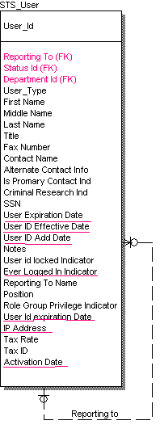
Database Auditing
Besides the above you can add some additional fields to store more information required for example if you store user information , you can add some additional fields like user creation date, User expiration date , Last login date and so on.
See below user table

Slide 22
CUSTOM Auditing Tables
Auditing by Using CUSTOM Auditing tables
Application level auditing works with the database to record information about a transaction as the application interacts with the database.
For those tables/columns that are configured to do so, as records are changed (added, deleted, or updated) in these tables, a database trigger replicates the change to a mirror table, thereby providing a complete, detailed audit trail of all changes including who, when, and what.

Slide 23

Database Auditing
DML Statement
Trigger
Perform Table
Table
Trigger Based Audit Architecture
Col Values
Columns /Rows
Col Values
Audit Table

Slide 24
Database Auditing (Contd.)
This mechanism consists of the following
Stored PL/SQL procedure executed whenever:
DML operation occurs
Specific database event occurs
DML events (trigger timings): INSERT, UPDATE, and DELETE
The DML changes can be performed on two levels:
Row level
Column level
The Audit table can have the following tributes
Audit sequence id ( Sequence number )
Emp id
Old Value
New Value
Date
Updated user
****In this example you are implementing auditing on salary filed. You need to have additional fields to implement auditing on more fields

Slide 25
Database Auditing (Contd.)
The following are the advantage of this method
Easy to implement
Can be implemented independent on most of RDBMS
Standard part of the application configuration
The following are the Disadvantage of this method
Trigger based solution. If there are more transactions there can be performance degradation
Cannot get any indication when the trigger is dropped
Additional columns are required for implementing audits for many columns
Additional no of tables and can be difficult maintain

Slide 26
Entity Attribute Value (EAV) Design
Common audit table using EAV Design (entity, attribute, value)
In order to overcome the large number of table required for auditing purpose , The common table approach can be used , in which the common table will be used for storing the audit records and information rather than creating one table each for each base table .
The following are the some of the key points that can be taken care of with this design
Flag users, tables, or columns for auditing
Application administrators can do it
User interface is built in top of the repository
Auditing columns are flexible

Slide 27
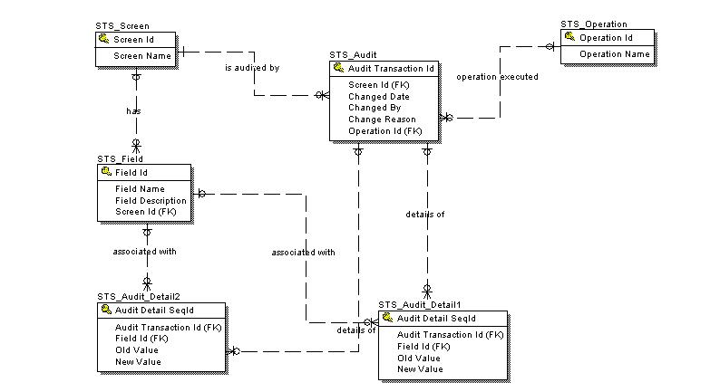
Database Auditing

Slide 28
Database Auditing (Contd.)
The following are the advantage of this method:
Easy to implement/maintain
Can be implemented independent on most of RDBMS
No of table required for auditing is drastically reduced
The following are the Disadvantage of this method:
Complex design – Difficult to understand
Trigger based solution. If there are more transactions there can be performance degradation
Cannot get any indication when the trigger is dropped
EAV ( entity attribute value ) based solution The data volume on STS_Audit_Detail /1/2 will be very high and additional tables are required to store if more tables needs to audited. May be horizontal partition can be considered for better performance

Slide 29
History Tables
Auditing using history tables:
One of the method to store the audit information in which the data will stored in separate tables (History) while records are being changed. This may be the most comprehensive and effective solution being to create history tables. The obvious benefit is when data is inadvertently changed or deleted, you can track down what happened as well as restore the correct information.
Good use for an audit trail, though. Providing read only access of the audit information to users, gives accurate and up-to-date history reports of the data.

Slide 30
History Tables (Contd.)
Consider the following tables.
Customer
Customer Id | Name | Phone
1 | Anirudhan Velur | 513-674-1772
2 | Vrajesh Mangalore | 513-674-1773
Customer History
History Seq Id | Customer Id | Name | Phone | Action | Action By | Action Date
1 | 1 | Anirudhan | 513-674-1772 | Insert | Sam | 12/01/2005
2 | 1 | Anirudhan | 513-674-1773 | Update | Tiger | 12/03/2007
3 | 1 | Anirudhan Velur | 513-674-1773 | Update | Tiger | 12/07/2007
4 | 2 | Anirudhan Velur | 513-674-1773 | Delete | Tiger | 12/12/2008
Notes:
Each row in Customer History represents a change that was made to a record in the Customer table. The history table contains information that is potentially very valuable to the users of the system you are creating. Why not make it available to them? Using the data above, you could create a screen that displayed the system history for Anirudhan Velur
If a user of your system wanted to know any of Anirudhan’s previous phone numbers, this customer history would show them. The alternative would be your user calling or emailing you and asking you to check for old phone numbers. There’s a time delay while they wait for you to get the message, check the database, and respond.
That’s even assuming that your user knows how to get in touch with you and is technically savvy enough to realize that an old phone number may be in the database somewhere. It’s probably more likely that it would never even occur to your user to ask. Which, of course, means a history screen is your opportunity to enjoy one of the most satisfying aspect of being a system designer. You get to surprise your user with a feature they didn’t even know they wanted. But once they start using it, they can’t remember how they got by without it.

Slide 31
Auditing by Storing Data Versions
Auditing by storing data versions
This is another popular method for auditing, design the system in such a way that , there wont be any deletes and updates only insertion
For example I want to update employee surname for emp id 2452 . normally you need an update statement , instead the new record with new version umber and new version will be used across the system rather than using old one .
While deleting the records there wont be any physical deletes only logical delete by changing the status of the record

Slide 32
Database Auditing
The below shown data can be standard employee table, which store the versions of records National skill repository.
Seq id(PK) | Name | Dept | Company | Joining date | Parent Seq Id((FK) | Version | Created by | Created date | Last updated by | Last updated date | Status Ind
2 | John | Software | CTS | 12/12/2004 | 1 | 2 | ABC | 12/12/2004 | ABC | 12/12/2004 | Y
3 | Abhy | Software | CTS | 1/12/2006 | Null | 1 | ABC | 1/12/2006 | ABC | 1/12/2006 | Y
4 | Hohny | IT IS | CTS | 10/07/2004 | Null | 1 | ABC | 10/07/2004 | ABC | /12/2006 | Y
1 | John | Software | TCS | 1/1/2002 | Null | 1 | KKK | 1/1/2002 | KKK | /1/2002 | N

Slide 33
Native Database Auditing
Native Data base Auditing
Most database vendors provide some form of native auditing. Microsoft SQL Server and Oracle Database Server provide a fairly robust set of auditing capabilities. This is implemented as a system that writes activity to tables, log files, or even the Event Viewer on Windows. There are several ways that activity can be recorded within Microsoft SQL Server and Oracle Database Server,
Oracle: Standard database auditing with additional Fine Grained auditing(FGA) , can DUMP the audit records into XML or combined with additional product ( additional cost) the Oracle Audit Vault
IBM DB2 : Audit traces that are provided at no cost and option combined with additional product ( Additional cost) , The IBM audit management expert(AME) stores audit records in a DB2 table
Microsoft SQL server : C2 Auditing and server side traces. Microsoft does not provides the much tools on auditing
Sybase: Minimal auditing support. Provides additional product Sybase data auditing (additional cost)

Slide 34
Third Party Auditing Tools
Third Party Auditing Tools:
Tizor Mantra
DB Audit
OmniAudit 1.11
Lumigent® Audit DB™

Slide 35
Checklist for Assessing Your Auditing Solutions
The following can be used as checklist for assessing your auditing solutions:
Is data-access capture complete, eliminating backdoors through which users (including DBAs) may access data without being detected?
What is the cost of deployment, especially across multiple servers?
Does the solution use triggers, which affect performance?
Does the solution require time consuming, expensive, and often incomplete application modification?
Is it easy to administer and maintain?
Is there a single console for configuration and scheduling across multiple database platforms?
Is there a common repository and long-term archival support?
Does it provide a complete modification history?
Does the solution “alert” on critical database changes (schema and permissions)?
Does the approach support multiple platforms?
Is the approach flexible enough to meet evolving requirements from regulators and business partners

Slide 36

Questions from participants

Slide 37
Test Your Understanding
Why Database auditing is required?
What are the common practices in auditing?
What are the advantages and disadvantages of each solutions?

Slide 38
Database Auditing : Summary
This chapter has dealt with the following:
Database Audit is keeping track of who did what and when.
There are various methods available for implementing data base auditing. The below are the common auditing solution can be implemented in all common business applications
Application Auditing
Auditing by adding additional columns
Auditing by Using Custom Auditing tables
Native Database Auditing
Auditing using 3rd party tools

Slide 39
Database Auditing : Source
http://otn.oracle.com
http://www.tizor.com/
http://www.petefinnigan.com
http://www.softtreetech.com/
http://www.acsac.org/
http://www.lumigent.com/products/audit_db.html
Disclaimer: Parts of the content of this course is based on the materials available from the Web sites and books listed above. The materials that can be accessed from linked sites are not maintained by Cognizant Academy and we are not responsible for the contents thereof. All trademarks, service marks, and trade names in this course are the marks of the respective owner(s).

Slide 40
You have successfully completed Database Auditing
Click here to proceed

